Slide 1
Image Classification Data (Fashion-MNIST)
Eng Teong Cheah

Slide 2
Objective
Despite its popularity, MNIST is considered as a simple dataset, on which even simple models achieve classification accuracy over 95%. It is hard to spot the differences between better models and weaker ones. In order to get a better intuition, we will use the qualitatively similar, but comparatively complex Fashion-MNIS dataset came out in 2017.

Slide 3
Contents
Image Classification Data (Fashion-MNIST)

Slide 4

Image Classification Data (Fashion-MNIST)

Slide 5
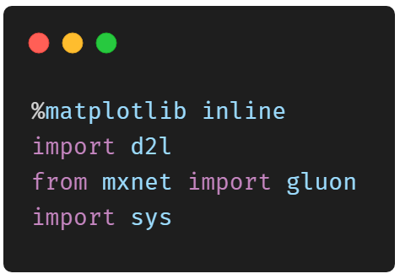
Getting the Data

Slide 6
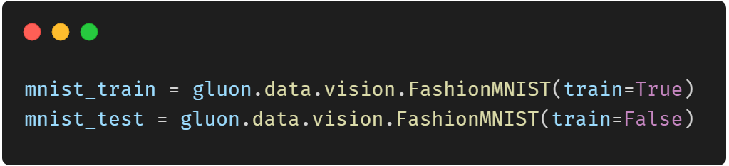
Getting the Data

Slide 7
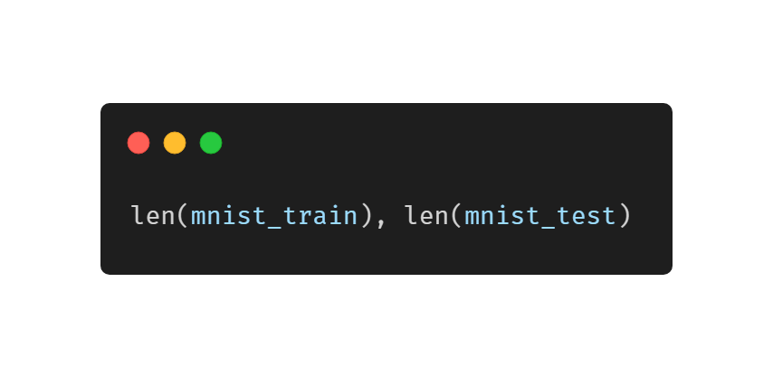
Getting the Data

Slide 8
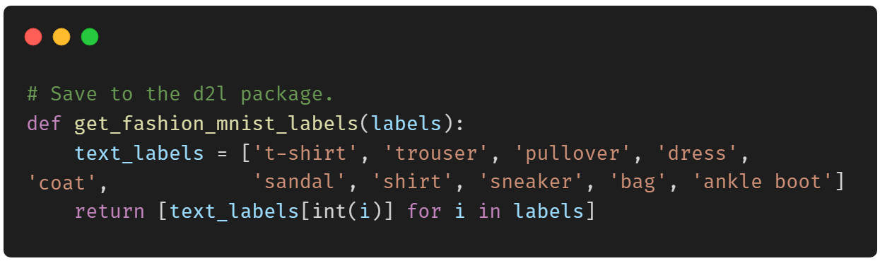
Getting the Data

Slide 9
Getting the Data

Slide 10
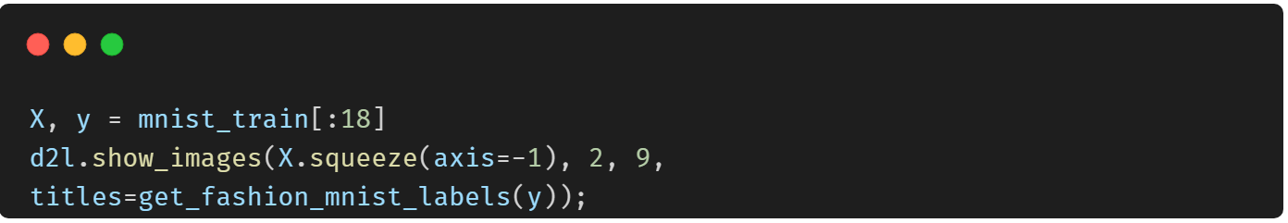
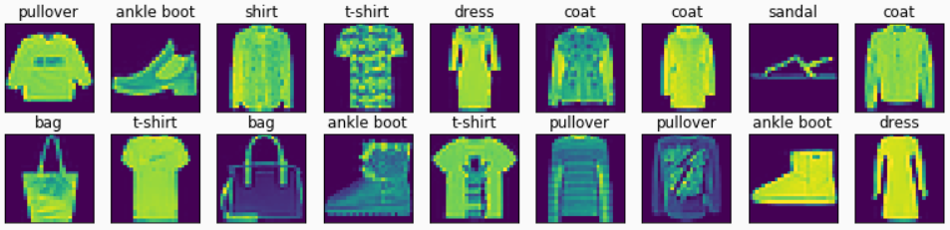
Getting the Data

Slide 11
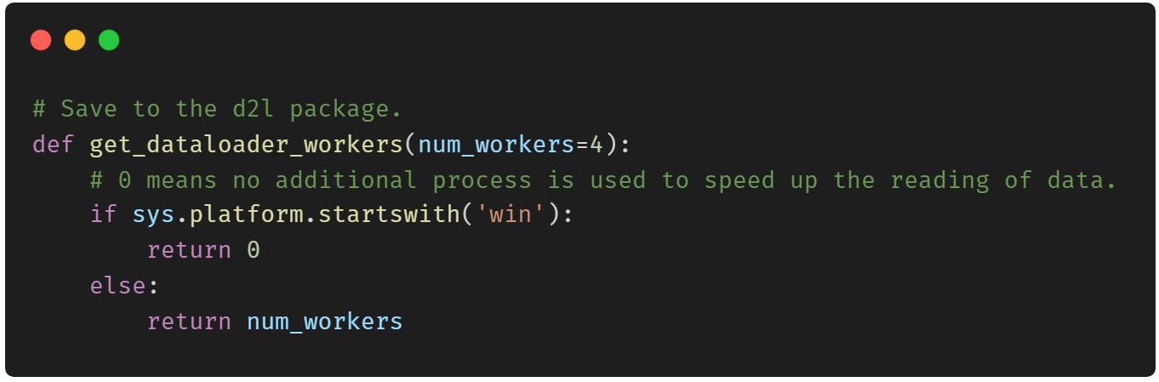
Reading a Minibatch

Slide 12
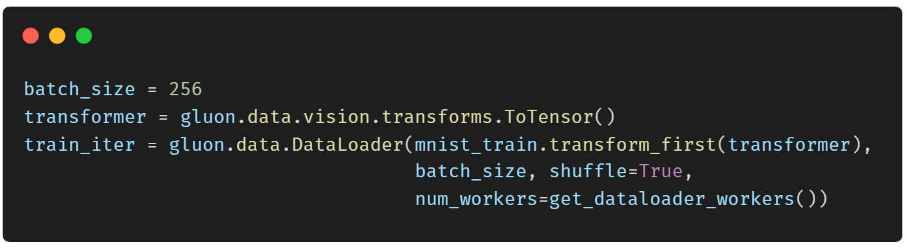
Reading a Minibatch

Slide 13
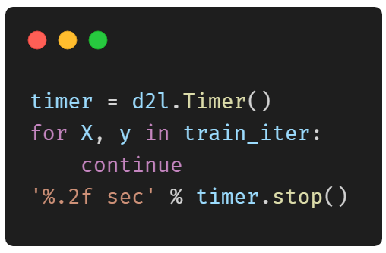
Reading a Minibatch

Slide 14
Thank You!
Does anyone have any questions?
Twitter: @walkercet
Blog: https://ceteongvanness.wordpress.com

Slide 15
Resources
Dive into Deep Learning

